Slide 1
Ascending order in 8085

Slide 2

05
03
02
04
01
Number of elements (n) in list : 05
1 st comparison :
05
03
02
04
01
03
05
02
04
01
2 nd comparison :
3 rd comparison :
03
02
05
04
01
4 th comparison :
03
02
04
05
01
Single pass
Final list:
03
02
04
01
05
Hence always will not get ordered list in single pass therefore we required more passes to get the ordered list
Number of passes = number of elements in list
Number of comparisons = number of elements in list - 1

Slide 3
Pass 1
Pass 2
Pass 3
List for
pass 1
05
03
02
04
01
List for
pass 2
03
02
04
01
05
List for
pass 3
02
03
01
04
05
1st CMP
05
03
02
04
01
1st CMP
03
02
04
01
05
1st CMP
02
03
01
04
05
2nd CMP
03
05
02
04
01
2nd CMP
02
03
04
01
05
2nd CMP
02
03
01
04
05
3rd CMP
03
02
05
04
01
3rd CMP
02
03
04
01
05
3rd CMP
02
01
03
04
05
4th CMP
03
02
04
05
01
4th CMP
02
03
01
04
05
4th CMP
02
01
03
04
05
Final List frm pass 1
03
02
04
01
05
Final List frm pass 2
02
03
01
04
05
Final List frm pass 3
02
01
03
04
05
Pass 4
Pass 5
List for
pass 4
List for
pass 5
02
01
03
04
05
01
02
03
04
05
1st CMP
02
01
03
04
05
1st CMP
02
01
03
04
05
2nd CMP
01
02
03
04
05
2nd CMP
01
02
03
04
05
3rd CMP
3rd CMP
01
02
03
04
05
01
02
03
04
05
4th CMP
01
02
03
04
05
4th CMP
01
02
03
04
05
Final List frm pass 4
Final List frm pass 5
01
02
03
04
05
01
02
03
04
05

Slide 4
Go to this site
https://www.sim8085.com/

Slide 5
To perform ascending order in 8085 we have to considered following instructions :
Required two counters : a) For number of passes (reg B) b) For number of comparison (reg C).
Load elements in to memory using following instruction : LXI H, memory addr (HL points to the memory address).
Contents of memory locations pointed by HL register can be accessed by M into accumulator (mov A, M).
Compare content of accumulator and memory using following instruction (CMP A, M).
For comparison following rules follow to check whether number is greater , smaller or equal.
Increment memory location INX H instruction is used.
If A < Reg / Memory | CF =1
If A = Reg / Memory | ZF =1
If A > Reg / Memory | CF =0 & ZF = 1

Slide 6
ascending order in 8085
0060 0061 0062 0063 0064
05 03 02 04 01
mvi b,05h reg b=05 03 05 02 04 01→after 1 comparison
upi2:lxi h, 0060h h=00 03 02 05 04 01 →after 2 comparison
l=60 03 02 04 05 01 →after 3 comparison
mvi c,04h reg c=04 03 02 04 01 05 →after 4 comparison
upi1:mov a,m a=05
inx h hl=0061
cmp m m=03 so compare m with a=05 a>m no carry
jc down jump if carry(but no carry)→ move next mov d,m d=03 mov m,a m(0061) and a=05 so→after instruction m(0061)=05 dcx h hl=0061→ after instruction hl=0060 mov m,d now m(0060)=05 and d=03→after instruction m(0060)=03 inx h hl=0060→after instruction hl=0061 down: dcr c c=04→after instruction c=03(c=c-1) jnz upi1 jump if not zero to upi1(value of c is not 0 so jump to upi1) dcr b b=05→after instruction b=04 jnz upi2 jump if not zero to upi1((value of b is not 0 so jump to upi2) hlt
pass 1
Swapping done

Slide 7
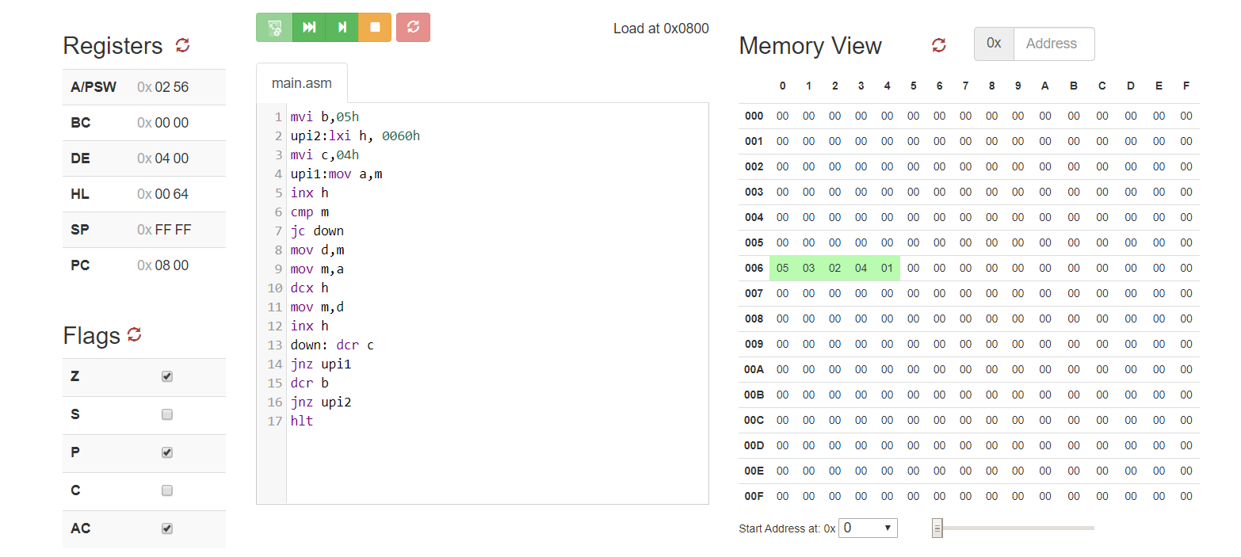

Slide 8
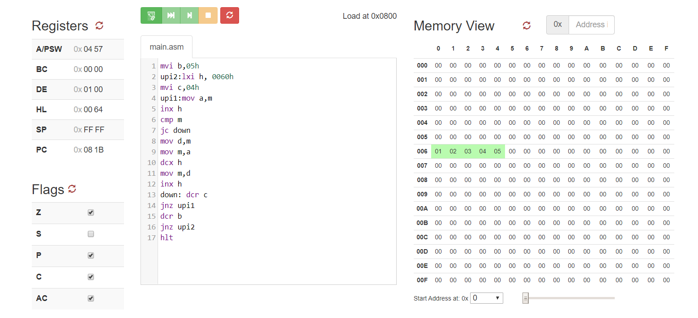

Slide 9
Descending order in 8085

Slide 10
descending order in 8085
0060 0061 0062 0063 0064
05 03 02 04 01
mvi b,05h reg b=05 05 03 02 04 01→after 1 comparison
upi2:lxi h, 0060h h=00 05 03 02 04 01 →after 2 comparison
l=60 05 03 04 02 01 →after 3 comparison
mvi c,04h reg c=04 05 03 04 02 01→after 4 comparison
upi1:mov a,m a=05
inx h hl=0061
cmp m m=03 so compare m with a=05 a>m no carry
jnc down jump if not carry(no carry)→ move to down mov d,m mov m,a dcx h mov m,d inx h down: dcr c c=04→after instruction c=03(c=c-1) jnz upi1 jump if not zero to upi1(value of c is not 0 so jump to upi1) dcr b b=05→after instruction b=04 jnz upi2 jump if not zero to upi1((value of b is not 0 jump to upi2) hlt
pass 1

Slide 11
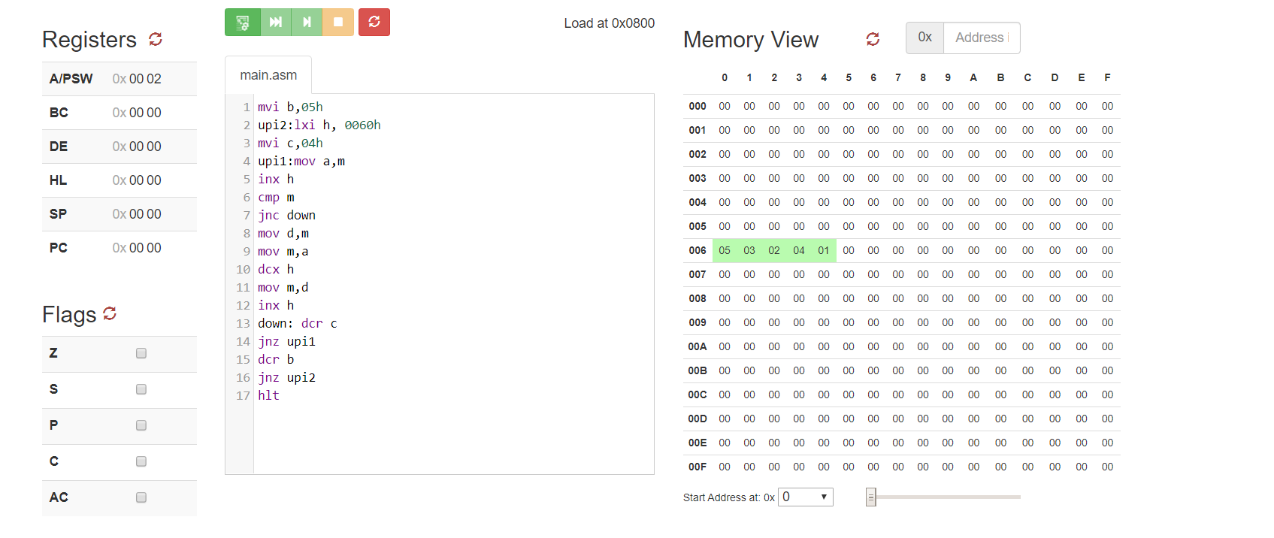
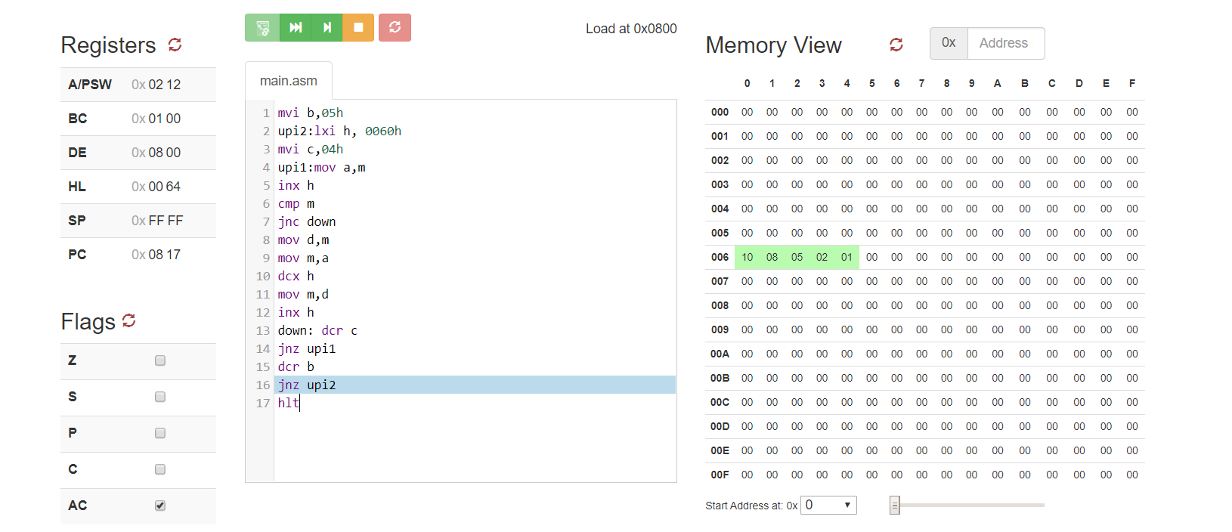

Slide 12
